Slide 1
Alma Mater Studiorum Università di Bologna
DevOps
PhD Student: Nicola Ghiselli
nicola.ghiselli@unibo.it
Sistemi Distribuiti M
CdS Laurea Magistrale in Ingegneria Informatica I Ciclo - A.A. 2019/2020

Slide 2
Outline
Introduction
Decentralized Version Control Systems
Dependency management
Build automation
Continuous integration
Sharing
Documentation
Notes:
Intoduction - 2 slides
GIT - 13 slides
Dependency - 4 slides
Build - 6 slides
Continuous - 6 slides
Sharing - 4 slides
Docs - 3 slides
References -

Slide 3
Outline
Introduction
Decentralized Version Control Systems
Dependency management
Build automation
Continuous integration
Sharing
Documentation

Slide 4
What is DevOps?
"DevOps is a set of practices that combines software development (Dev) and information-technology operations (Ops) which aims to:
shorten the systems development life cycle
provide continuous delivery with high software quality."

Slide 5
Why DevOps?
Company works are a collaborative activity
Rarely an activity is carried on by a single worker
Teamwork is key
Coordinating teamwork and working in parallel is difficult
Research requires reproducibility
Too often published results are not reproducible
The software (product or configuration) used to generate/process the results is not available
The actual data used by the authors are not available

Slide 6
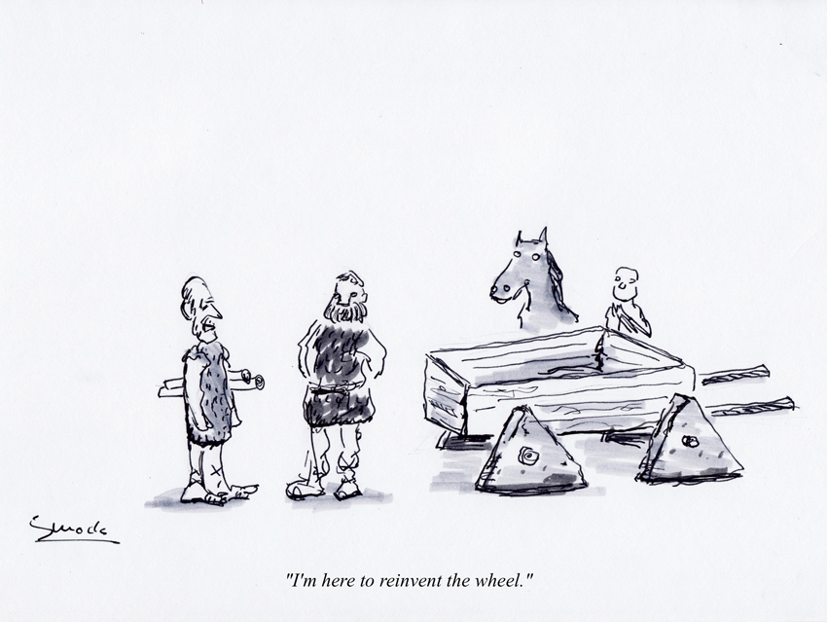
Many rendundand problems
Deal with software dependencies
Softwares must be
Built;
Packaged;
Documented;
Deployed;
Maintained;
…....

Slide 7
Outline
Introduction
Decentralized Version Control Systems
Dependency management
Build automation
Continuous integration
Sharing
Documentation

Slide 8
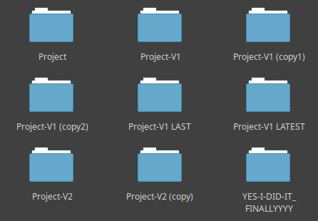
Basic Strategy
Basic strategy everybody applied at least once (be honest...)
work on project
if status is kinda ok, copy everything in a folder
(optionally) put a version or a date to the folder name
(optionally) compress the folder
go to 1

Slide 9
Tool Strategy
Differential tracking: only store differences, not copies
History navigation: ability to roll back in time
Partial roll backs: ability to roll back only sub-part of the project
Annotation of versions (with messages, numbers or names)
Automatic generation of dates
Author tracking
Possibility to select the parts of a project to save
You are only interested in non-regenerable resources
They often are only a part of a project

Slide 10



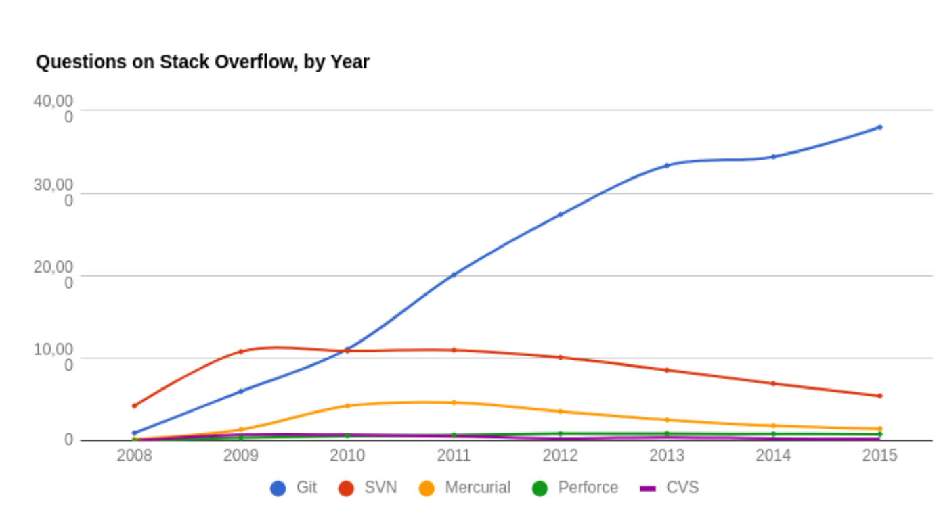
Git

Slide 11
Git - Repository
Folder containing all the files tracked by git. Includes:
Set of files that are or have been tracked
Metadata related to each file
permits
owner
date changed
Information required to retrieve any previous version of any file ever tracked
The whole history of save points
Note: All the metadata are stored in a .git hidden subfolder

Slide 12
Git – Differential Tracking
git tracks differences, not snapshots
Every save point can be seen as the set of differences between the previous save and the current state
Every state of the project is conceptually a sequence of differences that, applied in order, transform an initially empty repository to the desired state
Efficient for text files
Less efficient for binaries and compressed files
if a binary resource is changed, is usually necessary to duplicate it, falling back to tacking snapshots

Slide 13
Git – Commit
Every “save point” is named “commit”. It includes:
A reference to a parent (previous) commit
If it’s the first commit, the parent is an empty repository
The set of differences that transform the status of the world at the parent commit into the current state
The author of the commit
The email of the author
The date of the commit
A unique hash code
A message describing differences
Optionally, a symbolic name and a second message (tag)

Slide 14
Git – Staging Area
Changes in queue for the next commit
We don’t always want to save all the changes
Often, we work on multiple files, but only want to commit a subset
The creation of a commit counts two phases:
Staging – Selection of files whose changes will be saved
Commit – Actual creation of the save point
Files can be added and removed from the stage before committing
At commit time, only the staged changes will be saved

Slide 15
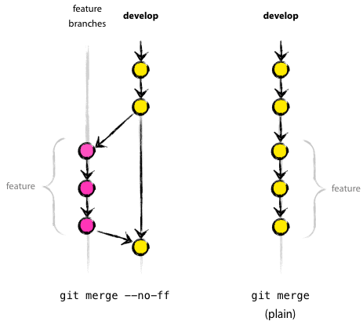
Git – Branch
Diverging development line
Going to an older commit and progressing from there creates a new
development line
Such development line is called branch
Branches can be worked on in parallel

Slide 16
Git – Merge
Converging development lines
Branches can be reunited with a merge operation;
Changes from both the development lines are merged together;
Delicate operation, merge conflicts can arise.

Slide 17
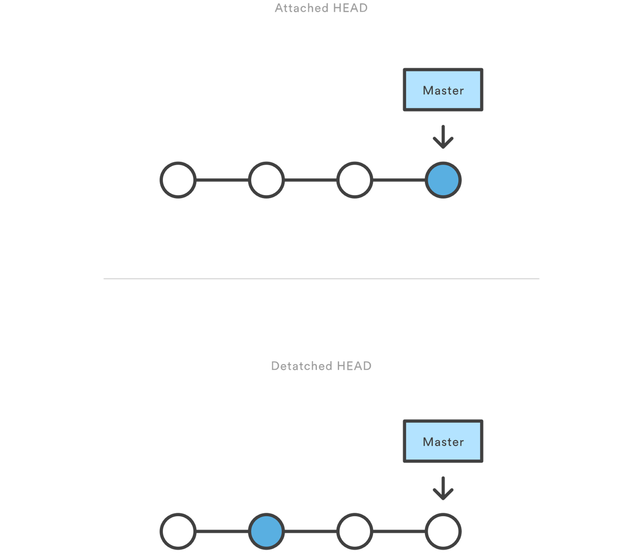
Git – Head
A reference to the commit we are currently working on
It is tipically at the end of a branch
When we are working on an intermediate commit (e.g. because we might want to start a branch) the status is called “detached head”

Slide 18
Git – Commands (local)
git init
git status
git add
(optional) .gitignore
git commit
git tag tagname
git log --all --graph
git diff
git checkout commitref
git checkout -b branchname
git branch
git branch -d branchname
git merge branchname

Slide 19
Git – Commands (decentralized)
git clone targeturi destination
git remote
git branch -u remoteName/remoteBranch
git checkout -b localname remoteName/remoteBranch
git fetch remote branch
git pull remote branch
git push remote branch

Slide 20
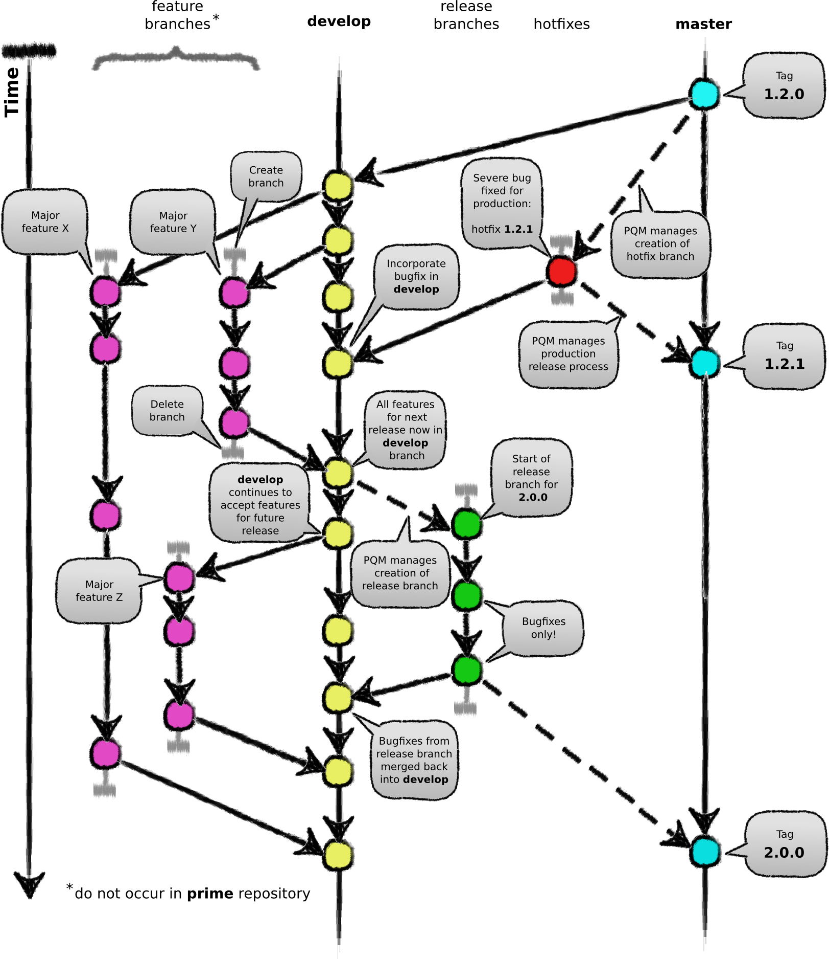
Git – Development Model

Slide 21
Outline
Introduction
Decentralized Version Control Systems
Dependency management
Build automation
Continuous integration
Sharing
Documentation

Slide 22
Concept
Any software depends on other software
All the runtime base libraries (think of java.lang.* and System.*)
All the other core libraries
Possibly, external resources (e.g., images, sounds...)
Normally, this software depends on other software
That depend on other software
That depend on other software, and so on...
A normal application has a tree of dependencies
(i.e. It is very common for a non-toy project to go over 100 dependencies)

Slide 23
Dependency Hell
Hard to search, download and verify compatibilities by hand
Version conflicts soon arise
one of your direct dependencies uses library A at version 1
another uses library A at version 2
you have a so-called transitive dependency conflict on A
Upgrading by hand requires, time, effort and tons of testing

Slide 24
Dependency Tool Desiderata
Declarative dependency specification
Automatic fetch and retrieve of the required dependencies
Automatic and configurable version conflict resolution
Multiple dependency scopes:
Compile Time
Test Time
Run Time
Configurable software sources

Slide 25
And now?
Dependency management is just the first need that arises!!
What you really want to automatize:
Dependency management
Software compilation
Testing
Documentation generation
Reports generation
Artefacts assemblage
Artefacts signing

Slide 26
Outline
Introduction
Decentralized Version Control Systems
Dependency management
Build automation
Continuous integration
Sharing
Documentation

Slide 27
Approaches
Imperative style - high flexibility, easy to customize
Custom scripts (in bash or similar languages)
CMake
Apache Ant
Declarative style - low flexibility, hard to customize
Apache Ivy (dependencies only)
Apache Maven
Python pip

Slide 28
Gradle - Idea
Pick the best of “declarative” build systems (i.e. Maven)
Dependency resolution
Conventions for easily building “standard” projects
Extensibility by plugin
Pick the best from “imperative” build systems (i.e. Ant)
Extreme flexibility
Customization by scripting

Slide 29
Gradle in a Nutshell (1)
The build is written in Domain Specific Language
Groovy is the historical hosting language (we are going to use this one)
Kotlin is the modern alternative
Inherits from Ant the concept of “target” (renamed as “task”)
Automatic resolution of the order in which tasks should be executed
Built-in dependency resolution as Maven

Slide 30
Gradle in a Nutshell (2)
Incremental builds and parallel task execution
Supports many languages
Java, Scala, Groovy, Kotlin, and C/C++ are first class citizens
Others supported via plugin
Maven-style extensibility via plugins
Allows test automation
Allows multi-project and multi-language builds

Slide 31
Gradle - Basics
A Gradle build is configured in:
the build.gradle.kts file for Kotlin-based build scripts
the build.gradle file for Groovy-based build scripts
the gradle.settings file for the (sub)project configurations

Slide 32
Gradle – Main Elements (1)
Plugins:
plugins {
id 'java'
id 'java-library'
id 'war'
id 'ear'
}

Slide 33
Gradle – Main Elements (2)
Repositories:
repositories {
maven { url 'https://mvnrepository.com/artifact/org.hibernate/hibernate'}
mavenLocal()
mavenCentral()
jcenter()
}

Slide 34
Gradle – Main Elements (3)
Dependencies:
dependencies {
providedCompile group: 'org.hibernate', name: 'hibernate-core', version: '5.4.5.Final'
runtime 'mysql:mysql-connector-java:8.0.17'
testCompile group: 'junit', name: 'junit', version: '4.12'
}

Slide 35
Gradle – Main Elements (4)
Tasks:
def wildfly_home="/home/nghiselli/Projects/DistributedSystemsM/JBoss/wildfly-17.0.1.Final"
task deployEar{
println("running dependencies.....")
dependsOn('ear')
println("dependencies resolved.....")
.
.
.

Slide 36
Gradle – Main Elements (5)
Tasks:
.
.
println("deploying war package.....")
println("deleting old deployments.....")
delete("$wildfly_home/standalone/deployments/distributed-systems-demo.ear")
println("old depployments deleted.....")
copy(){
from "$buildDir/libs/distributed-systems-demo.ear"
into "$wildfly_home/standalone/deployments/"
}
println("Application deployed!")
}

Slide 37
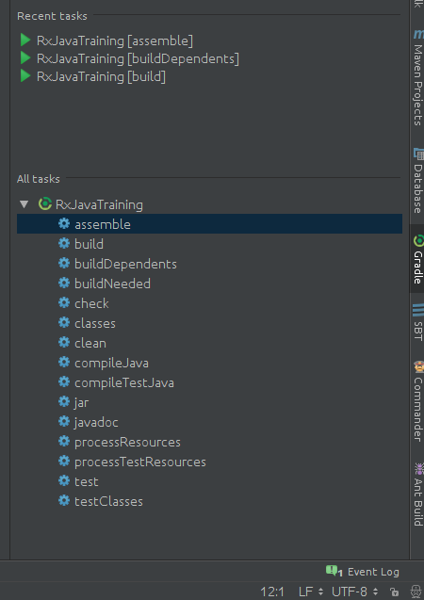
Gradle – Main Elements (6)
IDE Plugins
Command line
gradlew <taskname>
i.e. gradlew build or gradlew deployEar

Slide 38
Outline
Introduction
Decentralized Version Control Systems
Dependency management
Build automation
Continuous integration
Sharing
Documentation

Slide 39


Why continuous? (1)
Avoid the integration hell:
Work in parallel
Don’t waste developers’ time with repetitive tasks
Don’t break stuffs
Time is money!

Slide 40
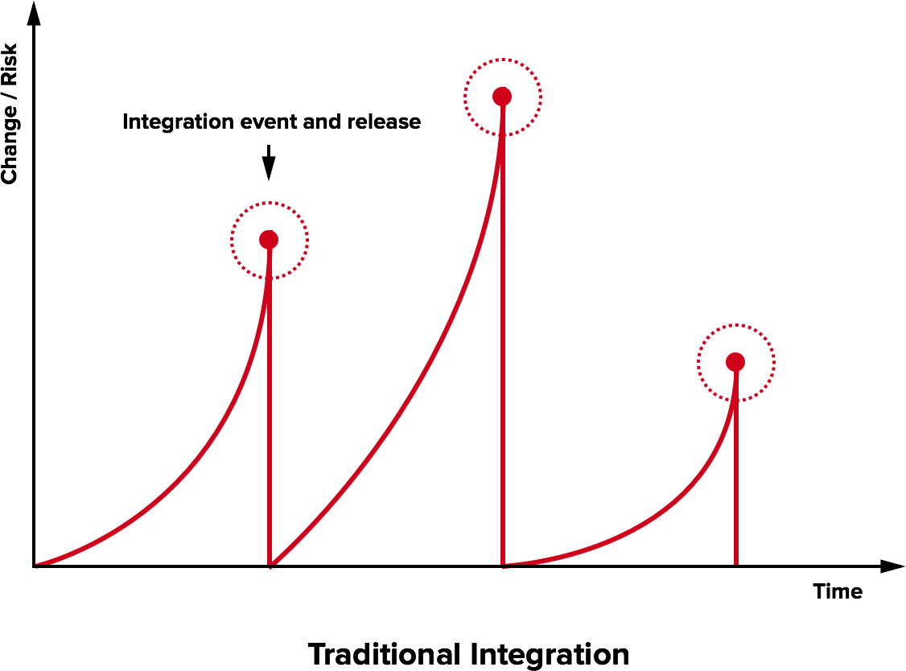
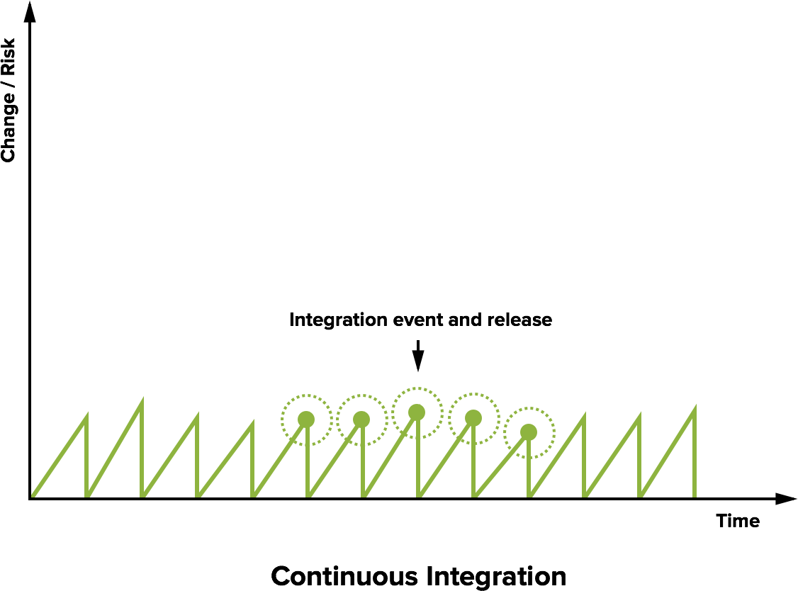
Why continuous? (2)

Slide 41
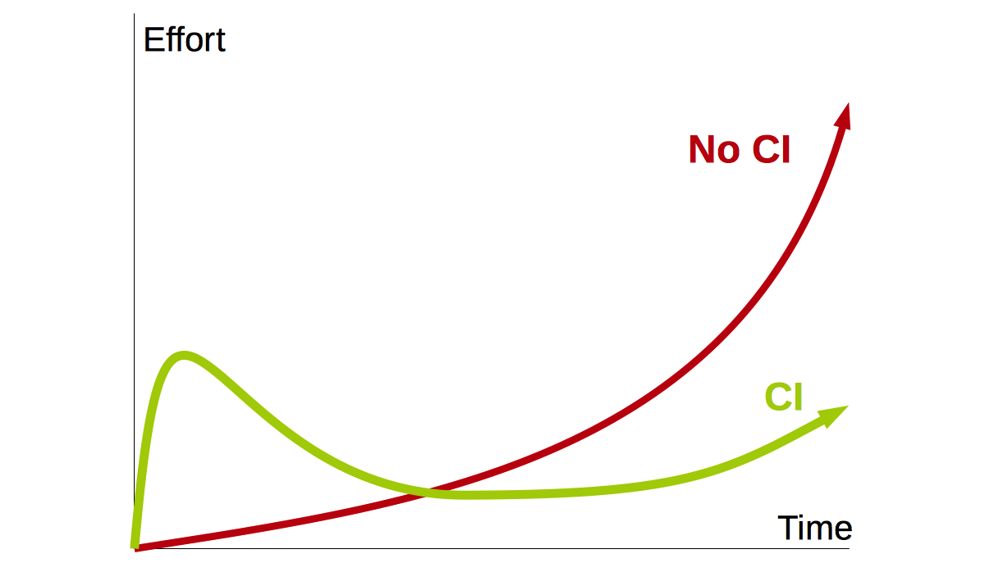
Why continuous? (3)

Slide 42
Why continuous? (4)
Allow prototype code ends up in production
Classically used with a negative meaning
Not so bad if done appropriately
Make it easy to access and use the latest prototype

Slide 43
Continuous Integration Software
Software that promotes the practice of continuous integration:
Runs a build for every change in the project
Prepares fresh environments where the builds are hosted
Notifies the results, e.g. if a failure occurs
Provides tools for deploying the produced artifacts
Hosted CI with free plans for open source projects are:
Circle CI, Codefresh, Codeship, drone.io, Pipelines, Travis CI, Wercker…

Slide 44
Travis CI
Web based
Well integrated with GitHub
Build results are displayed in the repo without intervention
Automatic build of any pull request
Free for open source projects
Cronjobs
Project-local configuration via YAML (in the .travis.yml file)
Out of the box support for Gradle
Dozens of deployment targets

Slide 45
Travis CI – Basic Example (1)
language: java jdk: - openjdk11 sudo: required dist: bionic
apt: packages: - google-chrome-stable before_script: - "export DISPLAY=:99.0" - sleep 3 install: - wget -N https://chromedriver.storage.googleapis.com/2.43/chromedriver_linux64.zip -P ~/ - unzip ~/chromedriver_linux64.zip -d ~/ - rm ~/chromedriver_linux64.zip - sudo mv -f ~/chromedriver /usr/local/bin/ - sudo chmod +x /usr/local/bin/chromedriver
…

Slide 46
Travis CI – Basic Example (2)
.
.
script: - ./myapplicationtest after_success: echo Build successful after failure: sudo mail -s "Build failure" ghiselli.nicola@gmail.com < /dev/null before_deploy: echo Preparing for deploy after_deploy: echo Deployment phase concluded.

Slide 47
Outline
Introduction
Decentralized Version Control Systems
Dependency management
Build automation
Continuous integration
Sharing
Documentation

Slide 48
What is a license?
A legal instrument used to regulate access, use, and redistribution of software:
retain some guarantees on the software;
be recognized as the original creator;
decide whether someone else can redistribute it
decide under which circumstances the software can be used
get paid if others use it
law can change greatly among countries;
Better choosing something proven to work

Slide 49
How select a proper license?
Copyright vs. Copyleft
Licensing vs. Ownership
Proprietary vs. Free
Free as in speech vs. free as in beer
Free vs. Open source
Unlicensed software

Slide 50
Most common license
GNU GPLv3
GNU LGPLv3
GNU GPL with linking exception I, II
MIT License
Apache License 2.0
WTFPL
Creative Commons Licenses

Slide 51
Apply a license
State the license clearly in the project
Apply a copyright notice header to each source file
Your software is now legally protected
Usually you need to add 2 files in the root of your project:
<LICENSE-TYPE>.txt (i.e. GPLv3.txt)
LICENCE.txt

Slide 52
Outline
Introduction
Decentralized Version Control Systems
Dependency management
Build automation
Continuous integration
Sharing
Documentation

Slide 53
Types for GitHub projects
Language Specific
JavaDoc
General Purpose
README.md (i.e. test reproducibility, API and so on)
Manual (i.e. for more elaborated softwares)
Static WebSite -> Jekyll

Slide 54
Jekyll
Blog-aware, static website generator:
Focus on content: write information and let the engine generate a website for you
Support for Markdown: no time spent in dealing with HTML/CSS
Support for templating: zero time spent on tuning the graphics, retaining a good result
Written in Ruby, installable via gem
Automatically executed by Github Pages!

Slide 55
GitHub Pages
GitHub associates a static website to every
User: http://username.github.io
Team: http://teamname.github.io
Repository: http://teamname.github.io/repositoryname
Website example:
HTML, CSS, Javascript (do you know Bootstrap?)

Slide 56
References
Additional Material:
https://liveunibo-my.sharepoint.com/:f:/g/personal/nicola_ghiselli_unibo_it/EqQxvHRgMHxBkHM-Lbpd66YBfkrPt-jmlt4e_gGgs1KDNA?e=zO6Bv6
Introduction:
http://losviluppatore.it/devops-una-introduzione-ragionata/
https://italiancoders.it/introduzione-al-devops/
https://dzone.com/articles/top-5-reasons-why-devops-is-important

Slide 57
References
Decentralized Version Systems
https://guides.github.com/
https://guides.github.com/activities/hello-world/
https://www.git-scm.com/doc

Slide 58
References
Dependency management
https://mvnrepository.com/
https://search.maven.org/
https://docs.gradle.org/current/userguide/introduction_dependency_management.html
https://maven.apache.org/guides/introduction/introduction-to-dependency-mechanism.html

Slide 59
References
Build Automation
https://docs.gradle.org/current/userguide/userguide.html
https://docs.gradle.org/current/userguide/tutorial_using_tasks.html

Slide 60
References
Continuos Delivery & Integration
https://jenkins.io/doc/book/pipeline/
https://www.guru99.com/jenkins-vs-travis.html
https://docs.travis-ci.com/
https://www.vogella.com/tutorials/TravisCi/article.html

Slide 61
References
Sharing:
https://opensource.org/licenses
https://www.gnu.org/licenses/license-list.html
https://creativecommons.org/licenses

Slide 62
References
Documentation:
https://help.github.com/en/articles/setting-up-a-github-pages-site-with-jekyll
https://help.github.com/en/articles/creating-a-github-pages-site-with-jekyll
http://jekyllthemes.org/
https://pages.github.com/
https://getbootstrap.com/

Slide 63
Alma Mater Studiorum Università di Bologna
Questions?
PhD Student: Nicola Ghiselli
nicola.ghiselli@unibo.it
Sistemi Distribuiti M
CdS Laurea Magistrale in Ingegneria Informatica I Ciclo - A.A. 2019/2020

